Slide 1
DEVELOPMENT OF AN ONLINE JOB PORTAL
GROUP 1:
ADVAIT NARVEKAR
ADESH MORE
ISHIKA GAIKWAD
JILL KARIA
VEDANT KADAM
COURSE: IST659 Data Administration Concepts and Database Management
INSTRUCTOR: Vincent Plaza

Slide 2
Team Information
Members | Role | Cross-train
Jill Karia | Business Analyst | Vedant
Adesh More | Developer | Jill
Ishika Gaikwad | Project Manager | Advait
Advait Naevekar | Database Administrator | Adesh
Vedant Kadam | UI/UX Developer | Ishika

Slide 3
Introduction
In the ever-evolving landscape of the job market, the initiative to develop an Online Job Portal is fueled by the imperative to simplify and enhance the intricacies involved in job searching and hiring processes. The Online Job Portal acts as a pivotal bridge, strategically connecting job seekers with prospective employers, facilitating a more seamless and efficient employment ecosystem.

Slide 4
Objectives
Intuitive User Interface
Robust Database Infrastructure
Sophisticated Job Matching Algorithm
Seamless Communication
Comprehensive Analytics Dashboard

Slide 5
Significance
The significance of this project is underscored by its commitment to addressing limitations observed in existing systems. By prioritizing user-friendliness, fortifying data security measures, and providing a more comprehensive service, the Online Job Portal aims to redefine and optimize the job search and hiring experience. Through these enhancements, the project endeavors to contribute positively to the efficiency and productivity of the broader job market ecosystem.

Slide 6
Literature Review
Online Job Portals' Impact:
Online job portals play a crucial role in modern employment by leveraging technology to connect job seekers and employers efficiently.
They offer a dynamic and adaptive approach, providing tailored matchmaking based on qualifications and preferences, thereby enhancing the overall effectiveness of the recruitment process.
Evolution of Job Matching Algorithms:
Recent advancements in job matching algorithms involve the use of machine learning and data analytics for more accurate and nuanced job recommendations.
These algorithms consider explicit user inputs and implicit signals like user behavior, aligning with the trend towards personalized experiences in job searches and ensuring adaptability to changing market dynamics.

Slide 7
PROJECT DESCRIPTION
Objectives & Features
User-Centric Design:
Create an intuitive user interface for the Online Job Portal, ensuring easy navigation and accessibility for users of varying technological proficiency.
System Infrastructure and Algorithmic Precision:
Develop a secure and robust database infrastructure, implementing a state-of-the-art job matching algorithm to precisely connect job seekers with suitable positions, optimizing overall efficiency in the job search and hiring process.
User-Centric Profiles:
Enhance user experience with a robust registration system, enabling job seekers to showcase skills and qualifications, and allowing employers to highlight company culture and job offerings.
Advanced Search and Filtering:
Provide advanced search tools, empowering job seekers to refine searches and enabling employers to efficiently filter through profiles, enhancing precision in job matching for a personalized experience.

Slide 8
PROJECT DIAGRAM

Slide 9
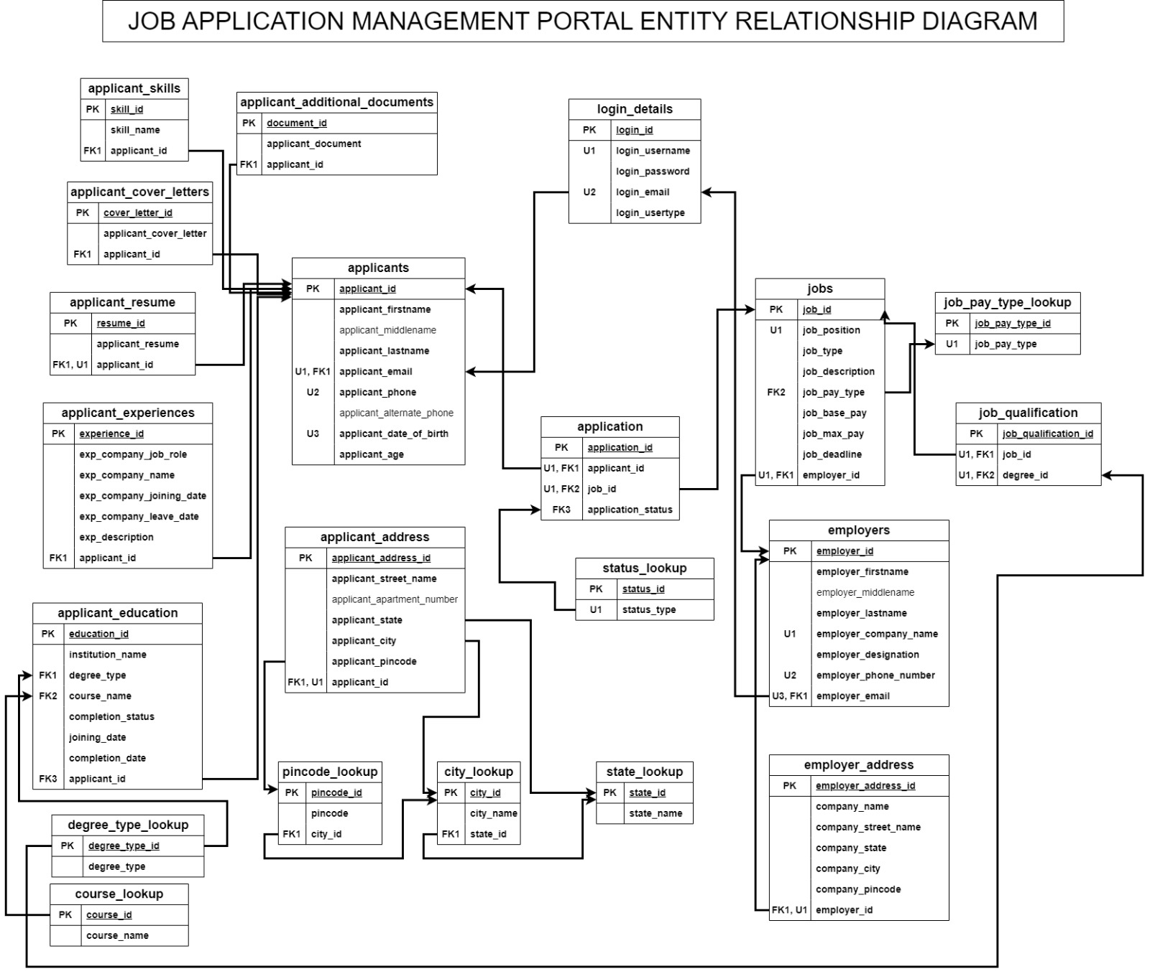
LOGICAL DIAGRAM

Slide 10
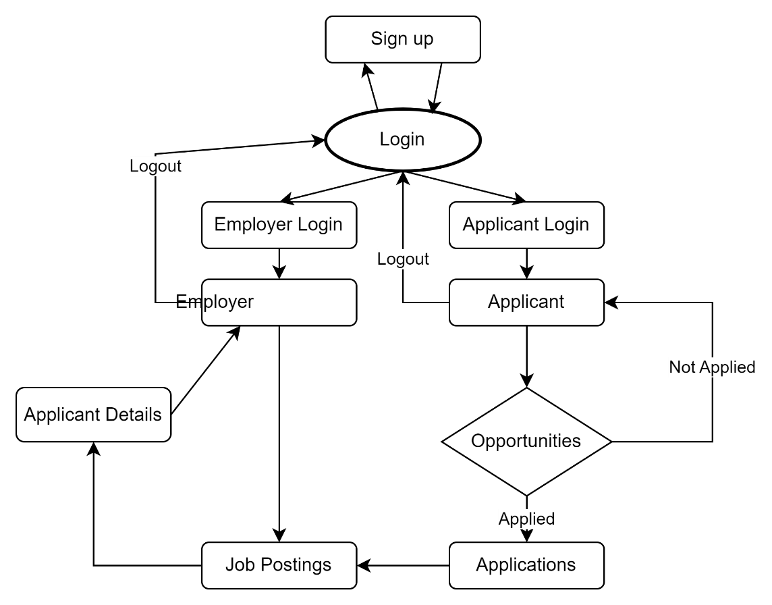
NAVIGATION DIAGRAM

Slide 11
System Architecture
Web Application
Database Management System (DBMS)
Database Schema
Security Measures
Document Handling
Application Workflow
Data Validation
Key Modules
User Authentication and Management
Job Seeker Module
Employer Module
Application Management
Reference Data

Slide 12
User Interface (UI) Design

Slide 13
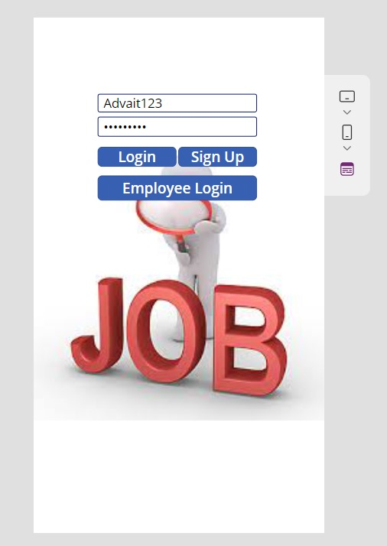
LOGIN PAGE
The login page presents a simple and straightforward interface, with fields for username and password, and options to log in, sign up, or proceed to employee login. A prominent 'JOB' lettering acts as a visual focal point, emphasizing the portal's purpose.

Slide 14
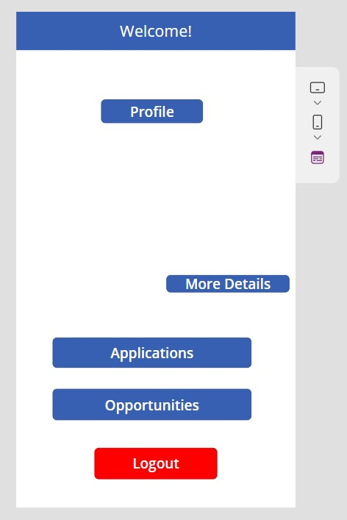
WELCOME PAGE
Upon login, users are greeted with a welcome page that is clean and uncluttered, offering clear navigation options - Profile, More Details, Applications, Opportunities, and Logout. The use of contrasting colors guides users naturally to the various sections of the portal.

Slide 15
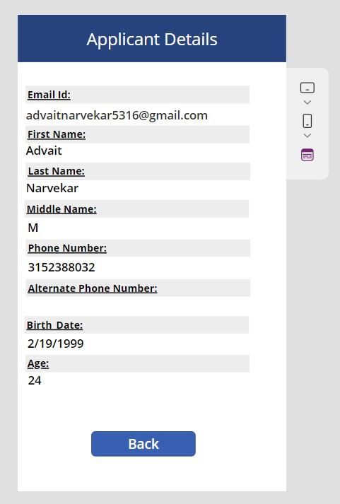
Applicant Profile
The Applicant Profile page is designed for ease of reading, displaying personal details like email, name, contact number, and age in a structured format. The layout ensures that users can quickly scan for relevant information.

Slide 16
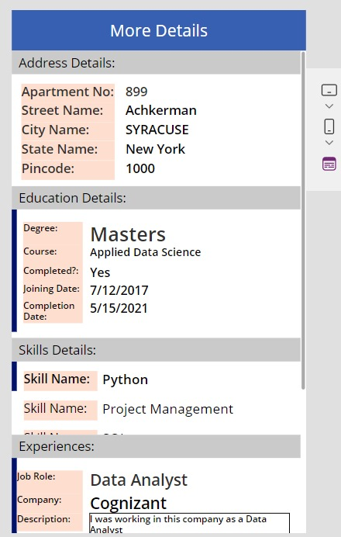
Detailed Information
The More Details page is comprehensive, covering address, education, skills, and experience. The information is compartmentalized into sections for quick reference, enhancing the user experience by making data management more efficient.

Slide 17
Results and Achievements
Successful Prototype Development:
The project started with a functional prototype, providing stakeholders with a tangible vision and facilitating early feedback for refining the project's direction.
Feature-Rich Application:
The Online Job Portal evolved into a feature-rich platform, offering user-friendly profiles, detailed job listings, resume upload, communication tools, and advanced search functionalities.
Positive User Feedback:
During beta testing, the platform received overwhelmingly positive feedback for its user-friendly interface, search capabilities, and communication tools, leading to further refinements.

Slide 18
Results and Achievements
Timely Project Delivery:
The project adhered to the established timeline, meeting milestones and deliverables on schedule through effective project management and a dedicated development team.
Scalability and Performance:
The Online Job Portal demonstrated robust scalability and performance, handling a substantial number of concurrent users without significant response time degradation.
Security Compliance:
Rigorous security testing and implementation of robust security measures ensured the confidentiality and integrity of user data throughout the development.

Slide 19
Results and Achievements
High User Adoption:
The platform experienced high user adoption rates, solidifying its position as a valuable resource in the job market for both job seekers and employers.
Continued Support and Maintenance:
Post-launch, the project team provided ongoing support, regular updates, bug fixes, and feature enhancements to meet user expectations and industry standards.
Future Roadmap:
The success of the Online Job Portal has paved the way for future developments, including expanding features, improving user experiences, and exploring mobile app development.

Slide 20
Challenges Faced
Technical Complexity:
Agile development and task breakdown facilitated the management of the extensive feature set, ensuring iterative development and quick issue resolution.
User Feedback Incorporation:
A systematic feedback collection process and prioritization allowed for effective management and implementation of improvements based on user input.
Data Security and Privacy:
A comprehensive security audit, encryption, access controls, and compliance measures were implemented to ensure the security and privacy of sensitive user data.

Slide 21
Challenges Faced
Scalability:
Load testing, performance optimization, and scalable architecture design addressed challenges in anticipating and accommodating future growth in user traffic.
Resource Constraints:
Efficient resource allocation, budget management, and prioritization, along with leveraging open-source technologies, enabled project success despite resource limitations.
User Training and Adoption:
User guides, video tutorials, webinars, and responsive customer support were employed to encourage user adoption and maximize the benefits of the Online Job Portal.

Slide 22
FUTURE ENHANCEMENTS
Machine Learning-Powered Job Matching:
Integration of machine learning algorithms to analyze profiles and historical data for more accurate and personalized job recommendations.
Enhanced Employer Tools:
Introduction of advanced employer tools, including automated interview scheduling, skill assessment tests, and video interviewing, to streamline the hiring process.
Skill Development Resources:
Addition of skill development resources such as online courses, webinars, and certification programs to empower job seekers and enhance their competitiveness.
Integration with Social Media:
Social media integration for easy job listing sharing and simplified registration/login processes using social media accounts.

Slide 23
FUTURE ENHANCEMENTS
International Expansion:
Expansion of the portal to include international job listings, considering cultural and legal differences in various regions.
Data Analytics Dashboard:
Development of a comprehensive data analytics dashboard providing insights into job market trends, salary benchmarks, and skill demand.
Enhanced User Support:
Continued investment in excellent customer support and chatbot assistance for prompt responses to user queries, fostering trust and satisfaction.
Gamification Elements:
Introduction of gamification elements to make the job search process engaging, with rewards or badges for achievements.

Slide 24
THANK YOU

